Slide 1
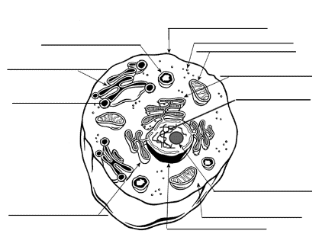
Write like a scientist!
Describe the Graph Questions Describe the overall trend (it goes up/decreases/levels off) Use the titles on the axis in your answer Include VALUES (NUMBERS) in your answer Depending on how many marks, possibly comment on any anomalies (outlying data). | Label/Draw Questions Clear, accurate and precise labels pointing to the correct part of the diagram Clear diagrams with at least the same number of annotations as there are marks available Use keywords in your labels | Describe Questions Descriptions of what you can see from the graph / image. The number of marks can indicate how many points to make. Use evidence or data from the figure in your answer. Do not explain- don’t say why- unless told. SAY WHAT YOU CAN SEE.
Compare Questions To be addressing both similarities and differences. Linking these together- two separate descriptions does not make a comparison! You’ll need words like: However In contrast On the other hand whereas | Explain Questions Extended sentences- making sure you answer ‘so what?’ after every sentence written. You can’t just list. Statements that are linked. An inclusion of figures / data / evidence to support your explanations. | Suggest Questions For 2 marks, one basic point developed with some explanation. Extend your point. For 4 marks, give 2 different points, not opposites, with explanations. If more marks are available, then make more points before developing them. You’ll need words like: Because This means Which will lead to
Calculate Questions USE YOUR CALCULATOR Is the question asking for units? Does your calculation sheet help? How many marks are there? This will tell us how many steps needed in the calculation Do I need to change the information given into the right units- for example minutes into seconds | Evaluate Questions You need to decide what the positives and negatives are of an action. You must explain you reasons for your argument. You must conclude! You’ll need words like: Firstly On the other hand Although In conclusion | Select and Justify Questions Select one of the options from those given and justify the choice. Use the resources given and your own knowledge / understanding. You’ll need words like: However On the other hand Overall
SAY WHY OR HOW

Slide 2
Write like a Scientist!
STEP 1: What is the question asking?
Calculate
Compare
Describe
Explain
Evaluate
State, give, name, write down
Label/Draw
Suggest
STEP 2: What information is given?
Numbers
Key words
Equations
Key points
Graphical data
Data table
Diagram
Notes
STEP 3: Check the marks
How many?
LAQ/SAQ?
STEP 4: Write the answer
STEP 5: Check the answer
Have you answered the question?
Have you used the given information?
Is you answer appropriate to the number of marks?
And finally… NEVER use the word IT in an answer.
e.g. As the area increases, it increases. What increases?
If there is any doubt you won’t get the mark.

