Slide 1
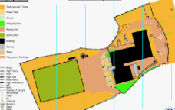
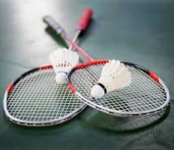
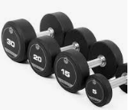
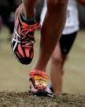
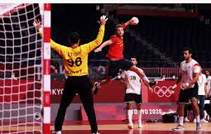
Continued
9. G: Rugby
B: Trampoline
10. G: Athletics
B: Badminton/Cricket
9. G: Rugby
B: Trampoline
11. G: Badminton/Rounders
B: Athletics
8. G: Outdoor Education
B: Dance
Term 5
Term 6
Continued
7. G: Trampoline
B: Fitness
Term 4
7. G: Trampoline
B: Fitness
6. G: Dance
B: Outdoor Education
Continued
5. G: Football
B: Handball
Term 3
5. G: Football
B: Handball
1. Baseline assessment: Cross country/skill circuit
3. G: Fitness
B: Basketball
Term 1
Term 2
4. G: Handball
B: Football
2. G: Netball
B: Rugby
Continued-
3. G: Fitness
B: Basketball
PE Y7 Curriculum

Slide 2
Continued
9. G: Rugby
B: Trampoline
10. G: Athletics
B: Badminton/Cricket
9. G: Rugby
B: Trampoline
11. G: Badminton/Rounders
B: Athletics
8. G: Outdoor Education
B: Dance
Term 5
Term 6
Continued
7. G: Trampoline
B: Fitness
Term 4
7. G: Trampoline
B: Fitness
6. G: Dance
B: Outdoor Education
Continued
5. G: Football
B: Handball
Term 3
5. G: Football
B: Handball
1. All:
Cross Country
3. G: Fitness
B: Basketball
Term 1
Term 2
4. G: Handball
B: Football
2. G: Netball
B: Rugby
Continued-
3. G: Fitness
B: Basketball
PE Y8 Curriculum

Slide 3
6. G: Trampoline/Badminton
B: Cricket/Athletics
6. G: Trampoline/Badminton
B: Cricket/Athletics
6. G: Athletics/Rounders
B: Trampoline/Badminton
Term 5
Term 6
5. G: Outdoor Education
B: Handball
Term 4
4. Competition for 4 lessons.
3. Rotation of: Netball/Basketball, Rugby, Football and Fitness
Term 3
4. G: Handball
B:Outdoor Education
Term 1
Term 2
2.Rotation of: Netball/Basketball, Rugby, Football and Fitness
1. Rotation of: Netball/Basketball, Rugby, Football and Fitness
PE Y9 Curriculum

